Slide 1
TEAM
BUILDING

Slide 2
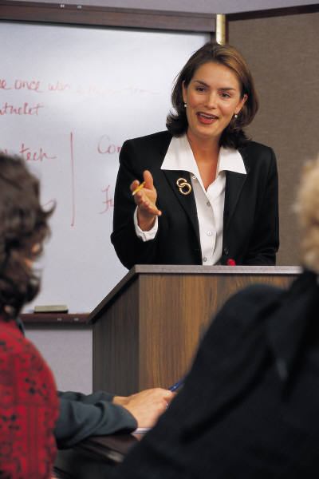
A. Principles of Effective Communication
What is communication?
The transfer of intended meaning.
2. What is communicated?
Ideas
Opinions
Concepts
Orders, instructions
Feelings

Slide 3

A. Principles of Effective Communication
3. Methods of communication.
Verbal
Written
Body Language
Example (action or lack of action)
4. Causes of Communication Problems
Lack of eye contact
One-way communication only
Lack of mutual understanding of goals or desired results
Different frames of reference
Feelings

Slide 4
A. Principles of Effective Communication
5. Defensive vs. Supportive Climates.
Defensive Climate Factors
Evaluation (judging) - implied (expression, speech, tone,etc.)
Control - evokes resistance (perception of implied inadequacy)
Superiority - indicates unwillingness to cooperate
Manipulation - causes feelings of resentment
Supportive Climate Factors
Description - view speech as genuine request for information.
Problem orientation - show sincere desire to collaborate
Empathy - sender identifies with receiver’s problems
Equality - defensiveness reduced
Provisionalism - sender communicates willingness to be flexible

Slide 5
A. Principles of Effective Communication
6. The Way to Effective Messages
Think through what you want to say before you say it.
Simplify your message.
Be specific; don’t beat around the bush.
Try to be as brief as possible.
Don’t assume.
Review important points.

Slide 6
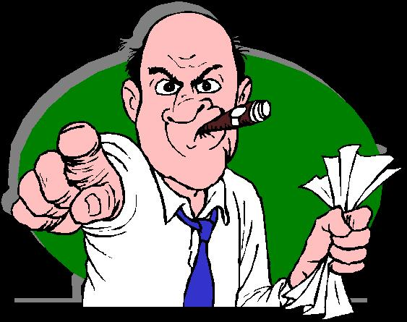
A. Principles of Effective Communication
Ineffective
Effective
“ You’re rude”.
“ You’re finishing my sentences for me.”.
“ Juanita, don’t you think Ed’s
chicken sort of reminds you of
something from The Far Side.”
“ Ed, I’ve got some second thoughts about
your barbecued chicken.”
“ How many times have you been
late this month?”
“ Is there something preventing you from
being on time?”
“ That will get you into trouble.”
“ If you continue to come to work late,
you’ll leave me no choice but to put you
on probation”

Slide 7
A. Principles of Effective Communication
7. Effective Feedback Techniques
Feedback is simply letting the speaker know you are listening.
Respond with statements or questions like:
- - “You believe that. . . “
- - “Are you saying that . . .” (triggering phrases, not judgemental)
- - “You’re concerned about . . .”
Use “door openers” to encourage speaker.
- - “Tell me more. . . “
- “Can you give me an example? . . .”
- - “Tell me in your own words . . .”
Ask questions
- - How? What? Where? Who? When? Why?
Feedback is probably the most under-used yet most helpful skill
in communication.

Slide 8
A. Principles of Effective Communication
8. Avoiding Verbal Turnoffs
Certain responses come across as rejection of another person’s
thoughts or feelings. Speaker may become defensive.
Preaching: . . . . . . . . “You should take my advice. . .”
Judging: . . . . . . . . . “But you’re wrong!”
Outdoing: . . . . . . . . . “You think you had it bad? Blah, blah, blah. . .”
Withdrawing: . . . . . . “Forget it!”
Patronizing: . . . . . . . . “You don’t really feel that way.”

Slide 9
A. Principles of Effective Communication
8. Avoiding Verbal Turnoffs
Killer Phrases throw up road blocks to potential solutions.
When someone uses a killer phrase, the speaker can only:
- - Fight back - and how often is that productive?
- - Ignore it - but the damage is done.
- - Sit down and shut up - and the idea dies.
Killer Phrases:
“Don’t be ridiculous!”
“Are you through?”
“We tried that before.”
“It won’t work.”
“We don’t want to be locked into that idea.”
“There you go again.”

Slide 10
A. Principles of Effective Communication
9. Keys to Effective Listening
The Bad Listener
The Key
The Good Listener
Continually interrupts.
Stop Talking
Gives speakers time to say what they have to say.
Tunes out if delivery is poor.
Judge Content not Delivery
Judges content, skips over delivery errors.
Tends to enter into arguments.
Hold Your Fire
Holds temper, doesn’t jump to conclusions.
Listens only for facts.
Listen for Ideas
Listens for important themes.
Influenced by who speaker is.
React to ideas, not speaker.
Pays attention to what speaker says, not who they are.
Shows little attention, or fakes it.
Show Interest
Actively listens to understand rather than only to reply.
Is easily distracted.
Resist Distractions
Avoids distraction, knows how to concentrate.
Gives no feedback.
Asks Questions
Encourages speaker to develop points further.
Reacts to emotional words.
Keep an open mind
Knows loaded words and phrases, but does not get hung up on them.
“Remember: You can’t listen if you’re talking.”

Slide 11
A. Principles of Effective Communication
10. Basic Principles for Human Relations
Create a supportive climate for all your interpersonal relationships.
- - Take constructive approach
Avoid personal attacks by taking a problem-oriented approach.
- - Objectively focus on the situation
Respect and enhance the self-esteem of others.
- - Necessary for creating a supportive climate
Set the example by taking constructive action at every opportunity.
- - Look for improvement opportunities and take action.

Slide 12
A. Principles of Effective Communication
11. Communication
Essential to teamwork - have a clear understanding of common targets.
Best tools for building cooperative relationships between employees.
Vital to the success of the company.
Examples of effective communication:
Assisting the team leader in developing standardized work instructions.
Communicating necessary information between team members.
Attending and participating in team meetings to continuously
improve performance.

Slide 13
“Complete all 10 questions - then we’ll check answers.”
A. Principles of Effective Communication
Team Building Part A Practice Exercises
1. What is communication?
a. The transfer of meaning.
intended
2. What is communicated? (circle) Yes or No
a. Ideas Yes No
b. Opinions Yes No
c. Concepts Yes No
d. Order, Instructions Yes No
e. Feelings Yes No
3. You can communicate with body language. (circle) True False
4. You can cause communication problems with lack of eye contact. (circle) True False
5. Fill in the blanks:
is implied by expression, manner of speech, tone of voice, or verbal contact.
evokes resistance.
arouses feelings of inadequacy.
makes people become resentful.
Evaluation or judging
Control
Superiority
Manipulation

Slide 14
A. Principles of Effective Communication
Team Building Part A Practice Exercises
6. The listener should not view speech as a genuine request for information. (circle) True False
7. Feedback is responding with statements or questions? (circle) True False
8. You are a bad listener if you tend to enter into arguments, show little attention and give no feedback. (circle) True False
9. Communication is often viewed as a tool that links individuals to the team, as well as team members
to the team leader. (circle) True False
10. Fill in the blanks:
encourage the speaker to say more about a problem.
“Door openers”

Slide 15
B. Group Dynamics and Interaction
1. Advantages of the Team Concept
Increased awareness of the contribution and role of each member.
Greater commitment to the team task because of increased participation
and pride in team accomplishments.
Increase in cooperative attitude among members.
Better quality decisions because of increased member input.
Greater commitment to decision implementation.
More creative problem solving.
Improved interpersonal relationships among members.
Improved communication in all directions
Increased efficiency in quantity and quality of work accomplished.

Slide 16
B. Group Dynamics and Interaction
2. Personal Skills for Working Together
Keep an open mind so you can go beyond the obvious.
Pursue new ideas. Don’t give up if , at first, it appears the idea won’t work.
Treat ideas equally. Do not try to assign a value to alternatives when they are suggested.
Look for the most interesting aspect of each idea.
Ask “good” questions.
Listen with interest and respect.
Ask: “How do you know ?”

Slide 17
B. Group Dynamics and Interaction
Conflict Resolution
Depending on how it is managed, conflict can have a positive or negative
effect on a team.
Disruptive conflict can slow or completely stall productive team work.
Understanding why conflict occurs can help in both avoiding it and in dealing
with it when it happens. Usually the result of:
- - A lack of understanding of the other person’s viewpoint.
- - Interpersonal resentment between individuals.
- - A competitive win/lose climate between individual members.
- - No constructive means of channeling it into deliberations.

Slide 18
B. Group Dynamics and Interaction
Guidelines for Resolving Conflict
Avoid personal attacks by taking a problem-oriented approach.
Describe how the conflict is affecting team performance.
Schedule a joint meeting between the involved parties.
Allow each person to objectively state his or her viewpoint.
Encourage each person to recognize that the problem needs resolution.
Allow each person to provide input into possible solutions.
Get agreement on what each person will do to resolve the conflict.

Slide 19

B. Group Dynamics and Interaction
3. Tuckman Model of Team Life Cycle
Forming
Team gets acquainted
- - Introductions
- - Shared experiences
- - Personal Interests
- - Personal histories
Team defines the task/ goal
- - Outcomes
- - Explanation of goals
- - Tasks needed to be done
- - Resources and support
- - Times lines
- - Frequency of meetings
Members are flexible, agreeable, but untrusting and careful about what they say. No procedures for working together.

Slide 20

B. Group Dynamics and Interaction
3. Tuckman Model of Team Life Cycle
Storming
Team experiences conflict about:
- - Team purpose
- - Team leadership
- - Task assignments
- - Team operations
Storming characteristics
- - Communication becomes more honest.
- - Disagreements become more frequent.
- - People differentiate their personal needs from those of the team.
- - Morale dips as people begin to think the team will never “get it together.

Slide 21
B. Group Dynamics and Interaction
3. Tuckman Model of Team Life Cycle
Forms of Storming
Negativity
- - Continual criticism of team activities.
Dissatisfaction
- - with anything and everything. Can lead
to negativity and other problems.
Hostility
- - Can take form of a person being aggressive,
argumentative, even threatening.
Crisis Mode
- - Team operating style where anything and everything is a crisis. Team must come
together and honestly confront the issues.
Shooting Down Ideas
- - Common activity. Can be a sign of all the other forms.
Thankfully, storming mode is temporary.

Slide 22
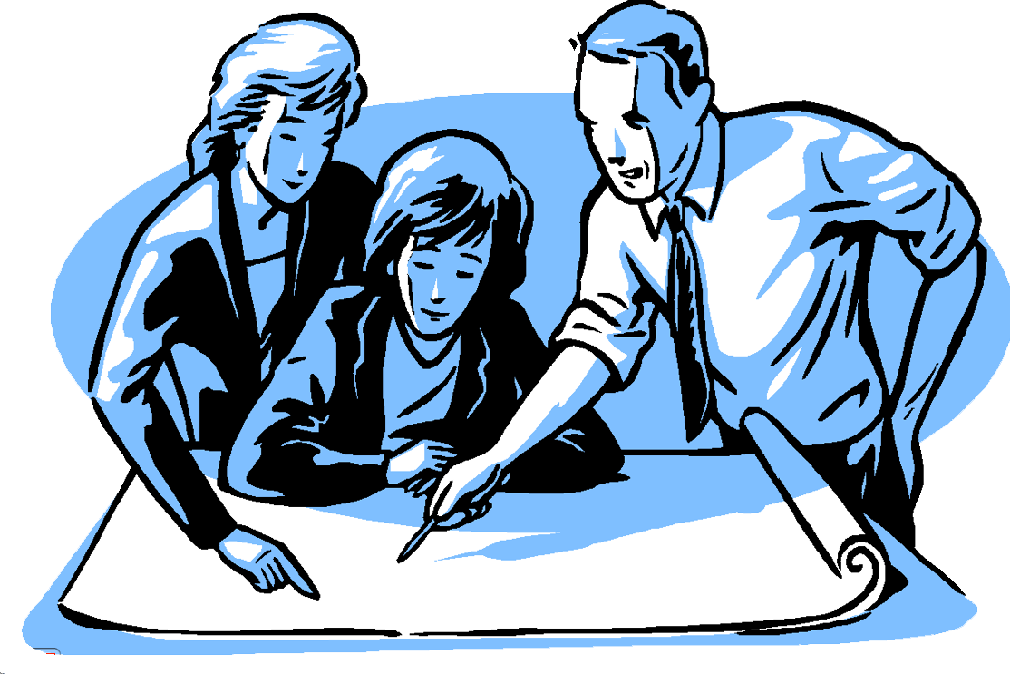
B. Group Dynamics and Interaction
3. Tuckman Model of Team Life Cycle
Norming
Group has overcome differences and agreed
on how it will operate.
Team rules and norms established:
- - How can the team exceed the “standard”
level of quality ?
- - What role each person is expected to play.
- - How group leadership will be addressed.
- - What types of communication will be used ?
- - What are the rules of communication ?
- - How often the group will meet.
“Stage represent the normal way the team will work.”

Slide 23

B. Group Dynamics and Interaction
3. Tuckman Model of Team Life Cycle
Performing
Working toward the goal the team has
established. (effective, efficient, healthy)
Team has established its goals and rules.
Team has developed a way to approach
and resolve conflict.
Team can identify and solve problems outside the group.
Everybody knows their role, what is expected of them and the quality
of work that must be done.
Communication is free and effective.
“Not all teams reach this stage, but success is still possible.”

Slide 24
B. Group Dynamics and Interaction
Team Building Part B Practice Exercises
1. Working in teams provides the organization and its employees both tangible and intangible benefits.
(circle) True False
2. Personal skills needed for working together are: (circle) Yes or No
a. Keep a closed mind. Yes No
b. Pursue new ideas. Yes No
c. Treat ideas equally. Yes No
d. Look for the most interesting aspect. Yes No
e. Ask silly questions. Yes No
f. Keep interrupting the other team members. Yes No
How do you know
3. When working with others, you should frequently ask: ?
4. Conflict between individuals is usally the result of a lack of understanding of the other person’s viewpoint. (circle) True False
2. What are Tuckman’s four stages of the Team Life Cycle?
a. ______________
b. ______________
c. ______________
d. ______________
Forming
Storming
Norming
Performing

Slide 25

C. Synergistics - Concensus Decision Making
1. Rationale for Worker Involvement in Problem Solving
The “worker team” is in the most advantageous position for fact finding because:
It is constantly observing raw facts.
Its sheer numbers help in fact finding.
Its accumulated years of experience lead
to tremendous insight.
Members get their hands dirty - have a
great desire to solve problems.

Slide 26
C. Synergistics - Concensus Decision Making
2. Synergism
“Cooperative action of discrete agencies, so that the total effect is greater than
the sum of the effects taken independently”.
Problems a team may encounter:
Confusion about defining the true goal of the team.
Hidden Agendas.
Interpersonal resentment.
Resentment about giving up individual territory.
Disagreement over procedures.
Strong competitive feelings between members.
Climate where people are afraid to voice their feelings, ideas and opinions.

Slide 27
C. Synergistics - Concensus Decision Making
2. Synergism
Building and Maintaining an Effective Team:
Create an environment where people feel safe to speak.
Get members to agree to cooperate..
Obtain a commitment from each member.
Allow the task, rather than people, to dictate procedures.
When differences arise, forge a compromise.
Be alert for opportunities to help the group succeed.

Slide 28
C. Synergistics - Concensus Decision Making
2. Synergism
Constructive Conflict:
Conflict, properly managed, can have a constructive effect on team function.
Conditions Leading To Constructive Conflict:
- Group acquires methods of managing conflict effectively.
- Members are committed to team goals.
- Members are open to differing opinions.
- Disagreements are confined to issues, not personalities.
Positive Effects:
- Increased group cohesion
- Members can trust each other.
- Pride shared by all.

Slide 29
C. Synergistics - Concensus Decision Making
Team Building Part C Practice Exercises
1. True or False:
The worker team is in the most advantageous position for fact finding
because its sheer numbers help in fact finding.
True or False:
Synergism is the ultimate goal of group decision making.
True or False:
One of the problems a team may encounter is “disagreement over
procedures”.
True or False:
One way to build and maintain an effective team is to forge a compromise
when differences of opinion arise.
True or False:
An effect of conflict is that members cannot trust each other to be fair
and open-minded.

Slide 30
D. Characteristics of a Team
Teams set clear and important goals.
Team structure is result driven.
Members are competent and committed.
Members collaborate freely.
Teams have principled leadership.
Leadership responsibility is shared.
Team is collectively stronger than the individual.
Teams work with other groups and systems.

Slide 31
D. Characteristics of a Team
1. Effective Teams
Members talk about, and agree upon how the team will operate.
Goals established by Arvin Meritor are discussed and the team plans.
on how to meet them.
Members can express their feelings and ideas.
Boundaries are identified and discussed.
Disagreements are constructively addressed.
Everybody contributes to the work of the team.
People are responsible for leading when needed; people follow in
support of the leader.

Slide 32
Team Building Part D Practice Exercises
Teams do not set goals. True or False
Members are competent and committed. True or False
Teams do not work with other teams in the manufacturing process. True or False
A good team member is one who takes the lead. True or False
Effective teams talk about and agree upon how the team will operate. True or False
Effective team members can express their feelings as well as their ideas. True or False
Effective team members do not contribute to the work of the team. True or False
People are responsible for leading when needed; people follow in support of the leader. True or False

